Slide 2
Microcontroladores
TE2015

Slide 3
OUTLINE
TE2015 Syllabus
The Von Neumann architecture
The Harvard architecture
Microchip fabrication process
The history of the microcomputer

Slide 4
Syllabus
TE2015 Microcontroladores

Slide 5
ABOUT THE PROFESSOR
Researcher at Technical University of Denmark
Adjunct professor at Tecnológico de Monterrey
Cofounder & CTO at AdSensors S.A.P.I. de C.V.
Research interests
Contact
WhatsApp: +45 5033-3514
E-mail: matias.vazquez@tec.mx
Teaching
Microcontrollers, Digital Systems, Computer Architectures, Embedded Systems
Van der Waals Heterostructures & Electrokinetics
UVM hardware Verification

Slide 6

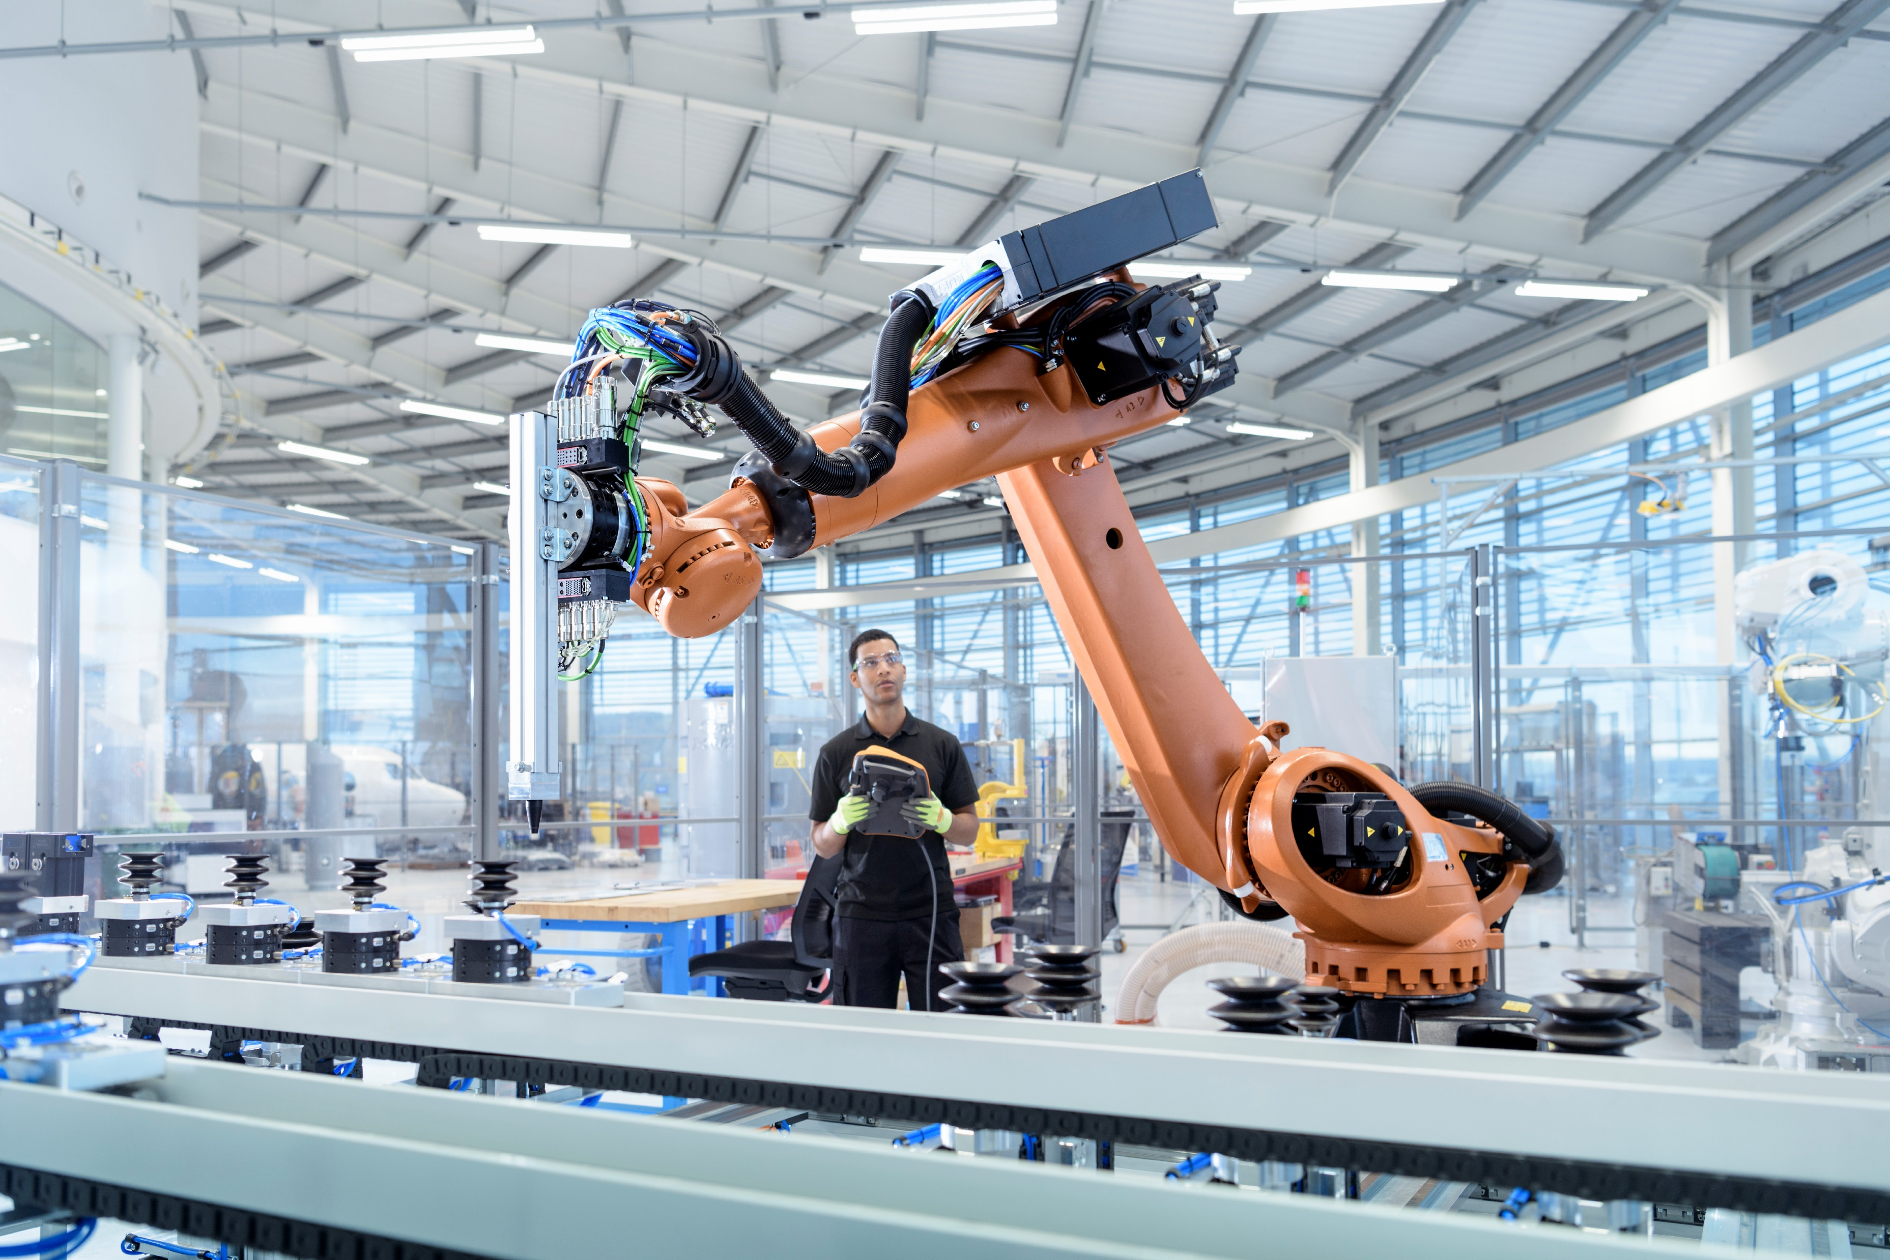
RESEARCH PROJECTS
Graphene-hBN Van der Waals Heterostructures (Technical University of Denmark)
Graphene stacking and encapsulation
Microfluidics & Electrokinetics
Challenges related to TE2015
Pico-liter syringe pump
Vacuum control in desiccator
Precise UV radiation in flood exposure chamber
Hardware verification of NAND Flash Controller (SAGE Microelectronique, Tecnológico de Monterrey & Hangzhou Dianzi University)
SystemVerilog testbench development under UVM framework
Master students at Tec de Monterrey

Slide 7
TO DOs BEFORE TUESDAY CLASS
Create an account on Autodesk (use @tec.mx e-mail)
Join our Autodesk group from the invitation e-mail received yesterday
Download and install EAGLE
Open an account on GitHub (use @tec.mx e-mail)
Create a repository for the class
Download and install GitKraken
EAGLE
Slack
Join our group on Slack from the invitation e-mail received yesterday
Install Slack app on your mobile or PC/Mac
GitHub
Make sure you can push your files from GitKraken to your repository
MPLAB X
Download MPLAB X from Microchip website and install it
Download XC8 C compiler from Microchip website and install it

Slide 8
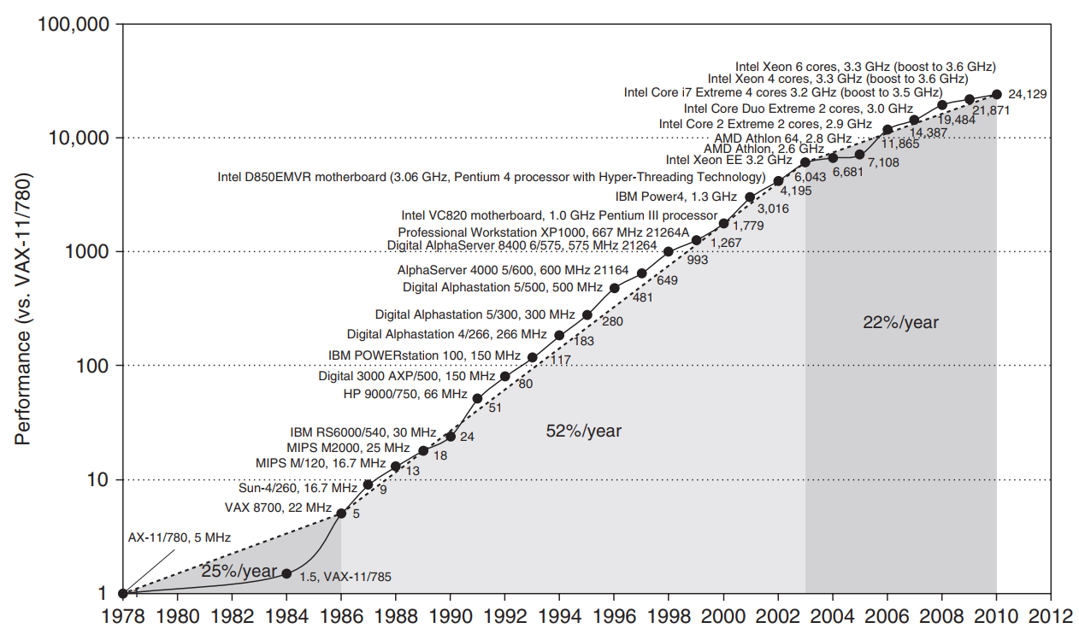
WHY A MICROCONTROLLERS CLASS?
APPLICATION
ALGORITHMS
PROGRAMMING LANGUAGES
OPERATING SYSTEMS/VIRTUAL MACHINES
INSTRUCTION SET ARCHITECTURE
MICROARCHITECTURE
REGISTER-TRANSFER LEVEL
LOGIC GATES
ELECTRICAL CIRCUITS
SEMICONDUCTOR DEVICES
PHYSICS

Slide 9
CLASS SCOPE
PIC18 Architecture
Curiosity Nano Board
Instruction Set
Memory Organization
PIC-AS
SFRs
GPRs
Embedded C
Integrated Development Environment
Hardware
Expansion Board
GPIO
Peripherals
Software
Timers
Interrupts
ADC
Serial Tx/Rx
User data
Data memory
1st Term
Introduction to microcontrollers
2nd Term
Embedded programming with C
Final Term
Use of timers
PIC18 microcontroller architecture
Memory organization in microcontrollers
Assembly language for PIC18
General-purpose input/output (GPIO)
Hardware interrupts and interrupt service
Analog to digital conversion
Serial communications

Slide 10
CLASS TOPICS
1ST TERM
Introduction to microcontrollers
FINAL TERM
Use of timers
2ND TERM
PIC18 microcontroller architecture
Memory organization of PIC18
Assembly programming
Embedded programming with C
General-purpose input/output (GPIO)
Hardware interrupts and interrupt service
Analog to digital conversion
Serial communications

Slide 11
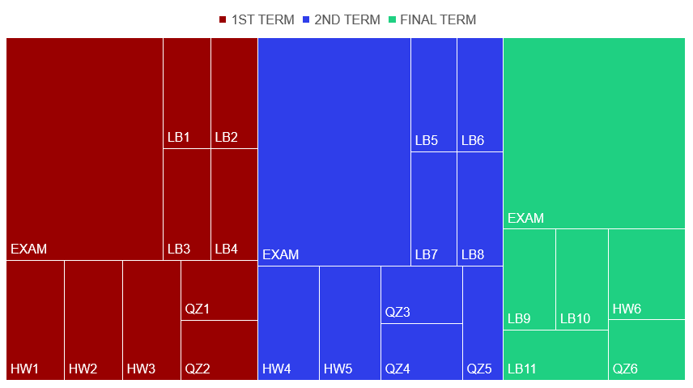
CLASS ACTIVITIES

Slide 12


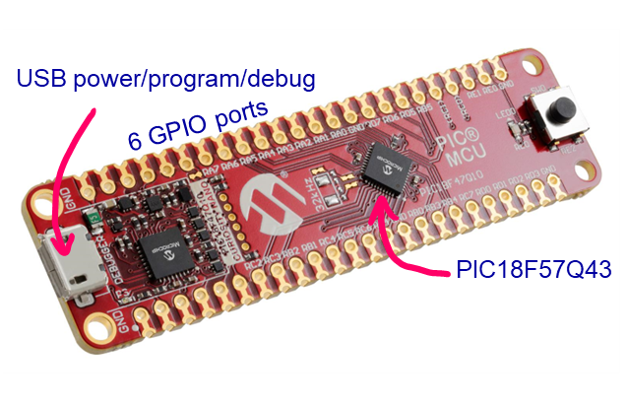
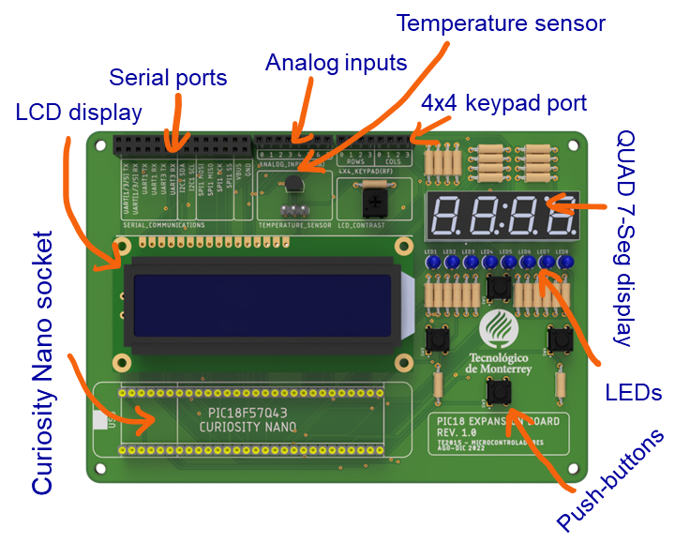
LABORATORY
Instruction Set
Software
Integrated Development Environment
PIC-AS
Embedded C
Hardware
Curiosity Nano Board
GPIO
Expansion Board
Peripherals
PIC18
WEEK | DATE | ACTIVITY | DESCRIPTION
1 | 08-Aug-22 | LB1 | Hardware design: schematic capture
2 | 15-Aug-22 | LB2 | Hardware design: physical layout
3 | 22-Aug-22 | LB2 | Hardware design: physical layout
4 | 29-Aug-22 | LB3 | Introduction to MPLAB and PIC18
5 | 05-Sep-22 | LB4 | Assembly programming of PIC18
6 | 12-Sep-22 | LB4 | Assembly programming of PIC18
7 | 19-Sep-22 | LB5 | High-level programming of PIC18 with C
8 | 26-Sep-22 | LB5 | High-level programming of PIC18 with C
9 | 03-Oct-22 | LB6 | GPIO: LCD display
10 | 10-Oct-22 | LB7 | GPIO: 4x4 keypad and 7-segment display
11 | 17-Oct-22 | LB8 | Hardware interrupts and ISR
12 | 24-Oct-22 | LB8 | Hardware interrupts and ISR
13 | 31-Oct-22 | LB9 | Timers, comparators and PWM
14 | 07-Nov-22 | LB10 | Analog inputs for microcontrollers
15 | 14-Nov-22 | LB11 | Asynchronous serial communications
16 | 21-Nov-22 |  | HOLIDAY

Slide 13
LABORATORY
11 laboratories
25% of class grade
3 students per team
2 deliverables
50% Demostrative video (maximum length of 3 min.)
50% MPLAB project
Self-enrollment on Canvas

Slide 14


CLASS RESOURCES
Integrated Develpment Environment
GitHub Repository
XC8 Compiler
MPLAB Xpress IDE
Laboratories
Datasheets
Examples
Simulations
Bibliography
Programming 8-bit Microcontrollers in C – Martin P. Bates
PIC18 & MPLAB Documentation
C Programming for the PIC Microcontroller – Hubert Henry Ward
MPLAB XC8 PIC Assembler
MPLAB C18 C Compiler
Interfacing PIC Microcontrollers to Peripheral Devices – Bohdan Borowik
PIC Microcontroller: An Introduction to Software & Hardware Interfacing - Huang
PIC18F57Q43 Datasheet
CURIOSITY NANO PIC18F57Q43 User Guide
Slack
Group Communications
Questions & Queries
File sharing
Team channels

Slide 15
The history of the microcomputer
TE2015 Microcontroladores

Slide 16
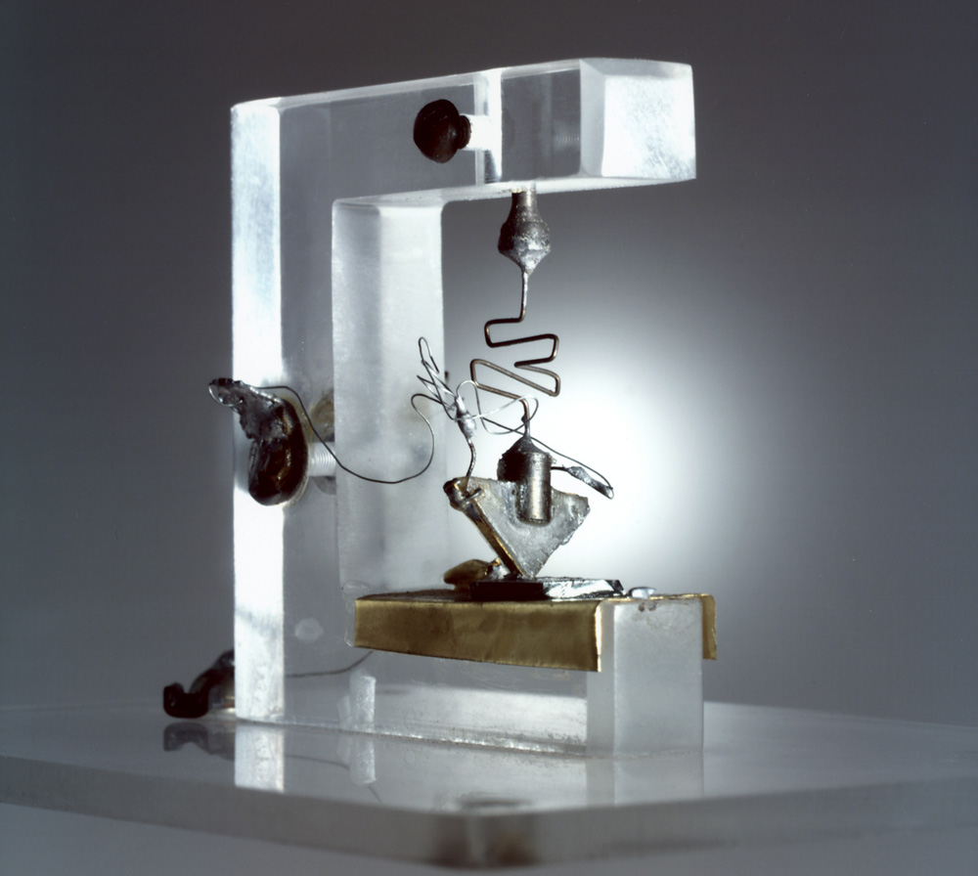
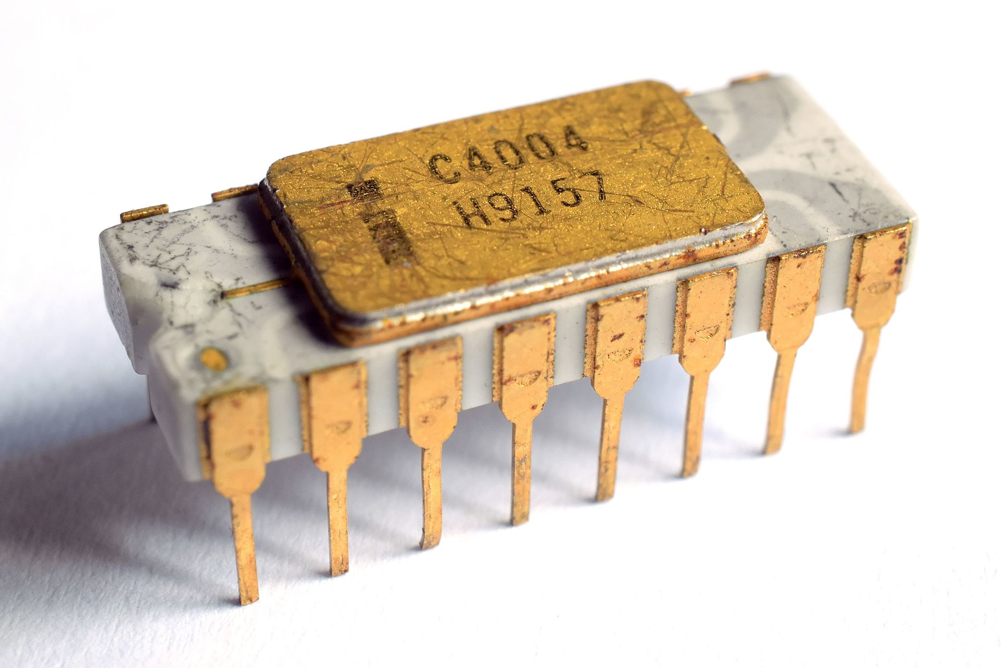
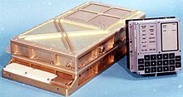
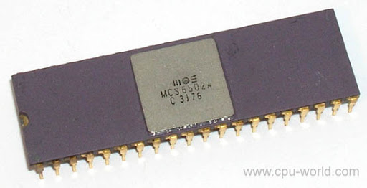


Invención del Transistor
Intel 4004
Inventado en Bells Lab
Hecho de Germanio
Junta bipolar tipo NPN
4 Bits, proceso MOS
Primer μprocesador commercial
Diseñado para calculadoras
1948
1966
1971
1975
16 Bits
Diseñada en el MIT
Usada para guía, navegación y control del modulo lunar del Apollo 11.
8 Bits
Microprocesador de bajo costo
Inició la revolución de la computación en casa
Apollo guidance computer
MOS 6502

Slide 17
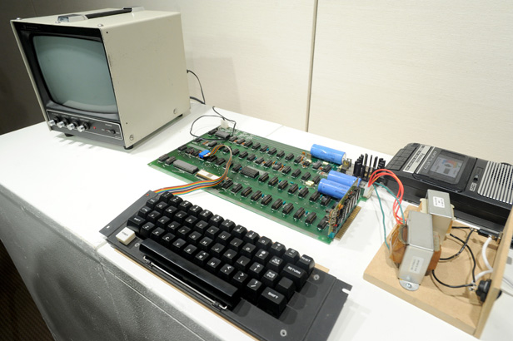
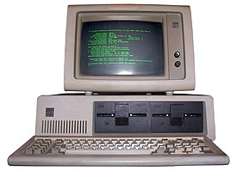
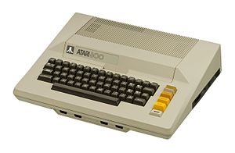
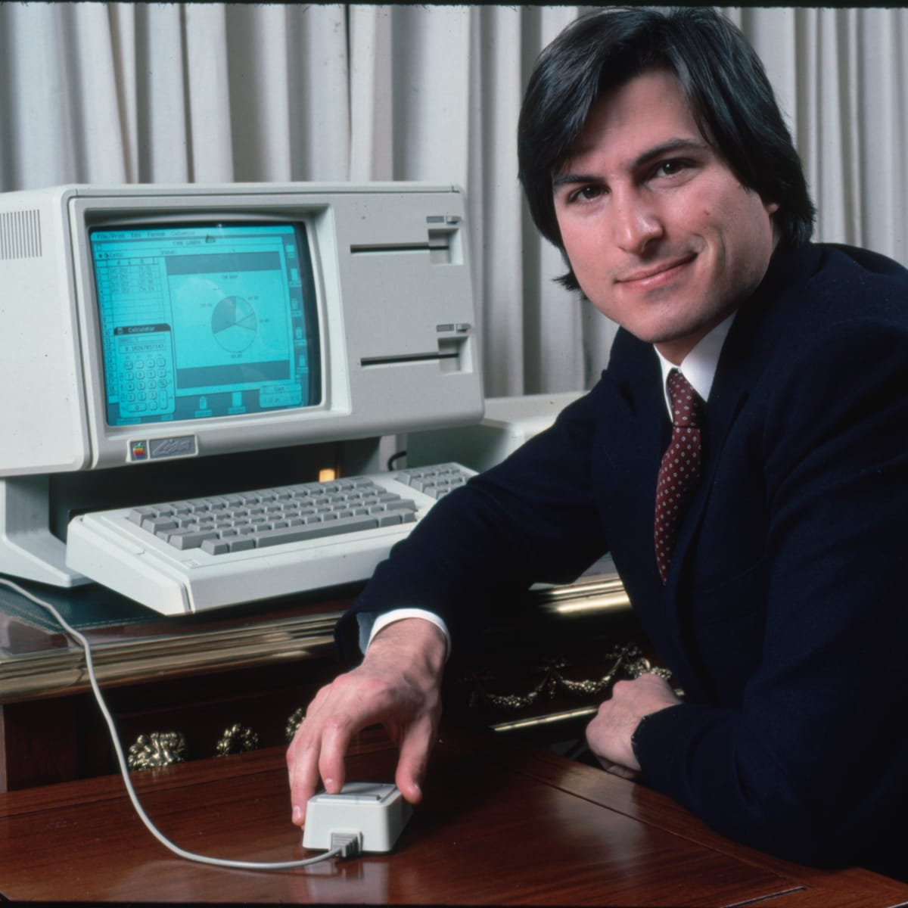
Apple 1
IBM PC (5150)
Procesador INTEL 8088 de 16 Bits
SO Microsoft MS-DOS
Introdujo el concepto de Computadora Personal
Incluía un MOS 6502
Fabricaron 200 modelos
Diseñada para uso recreativo
1976
1979
1981
1983
Incluía un MOS 6502
Diseñadas para juegos y computadora personal
Integraba un teclado completo
Motorola 68000 de 16/32 Bits
SO Lisa OS
Primera PC con interfaz gráfica.
Fracaso comercial
Atari 400 y 800
Apple Lisa

Slide 18
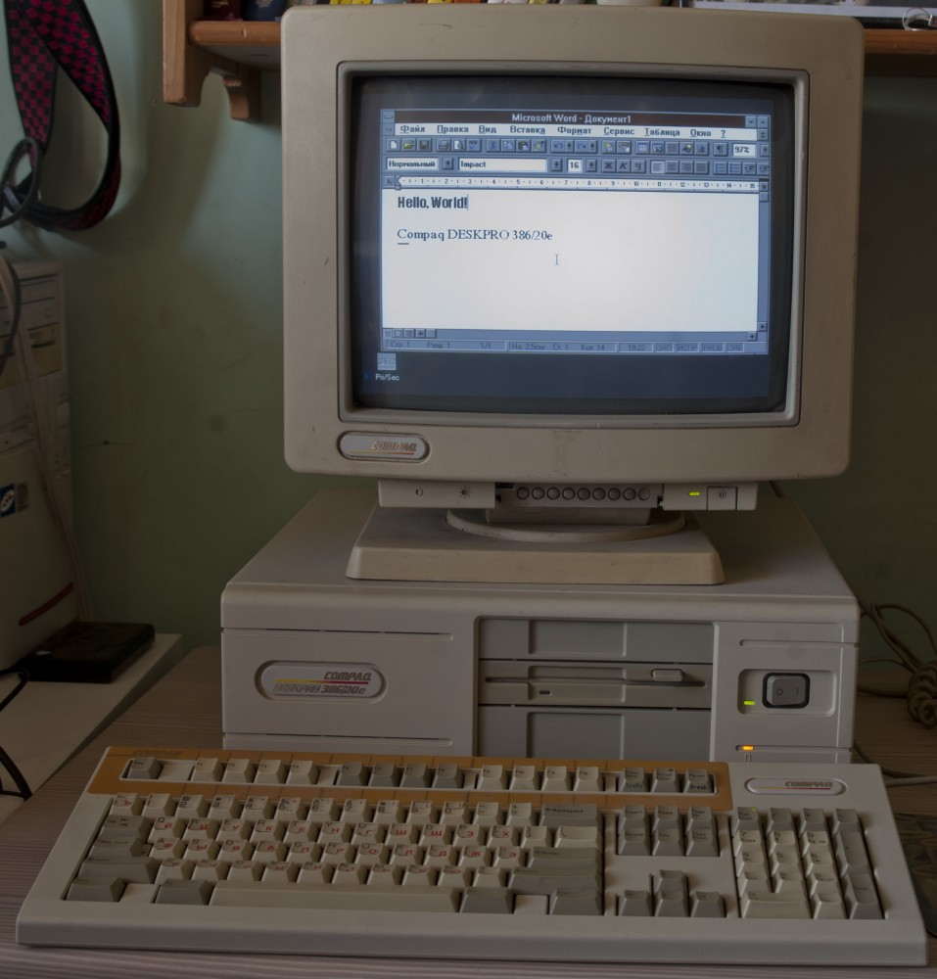
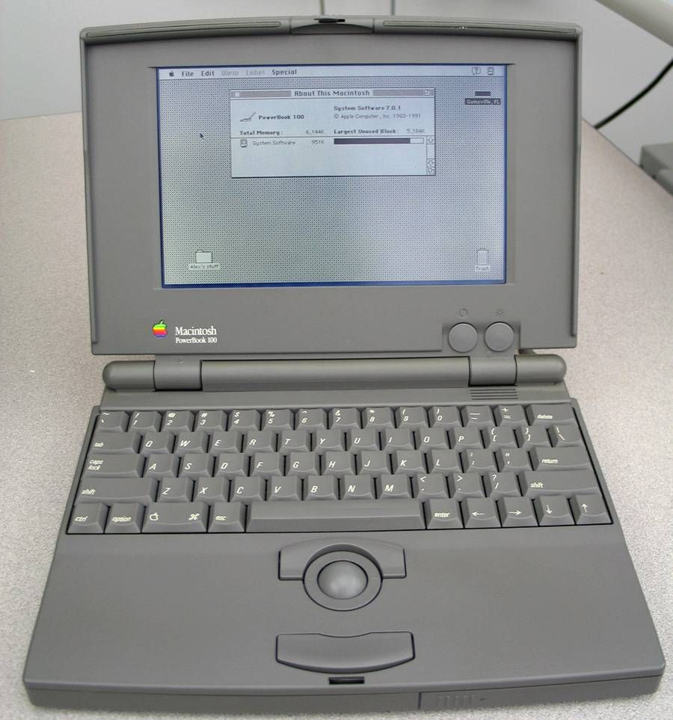
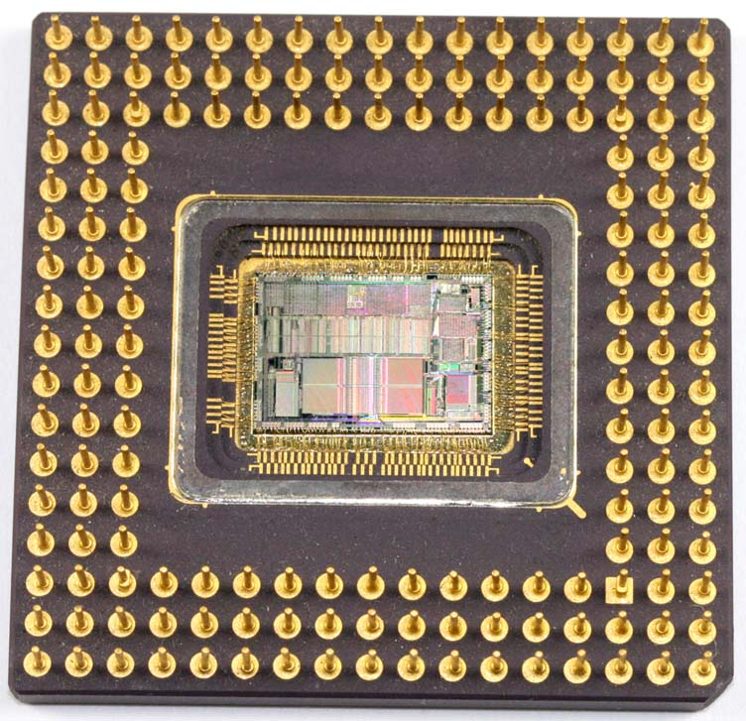
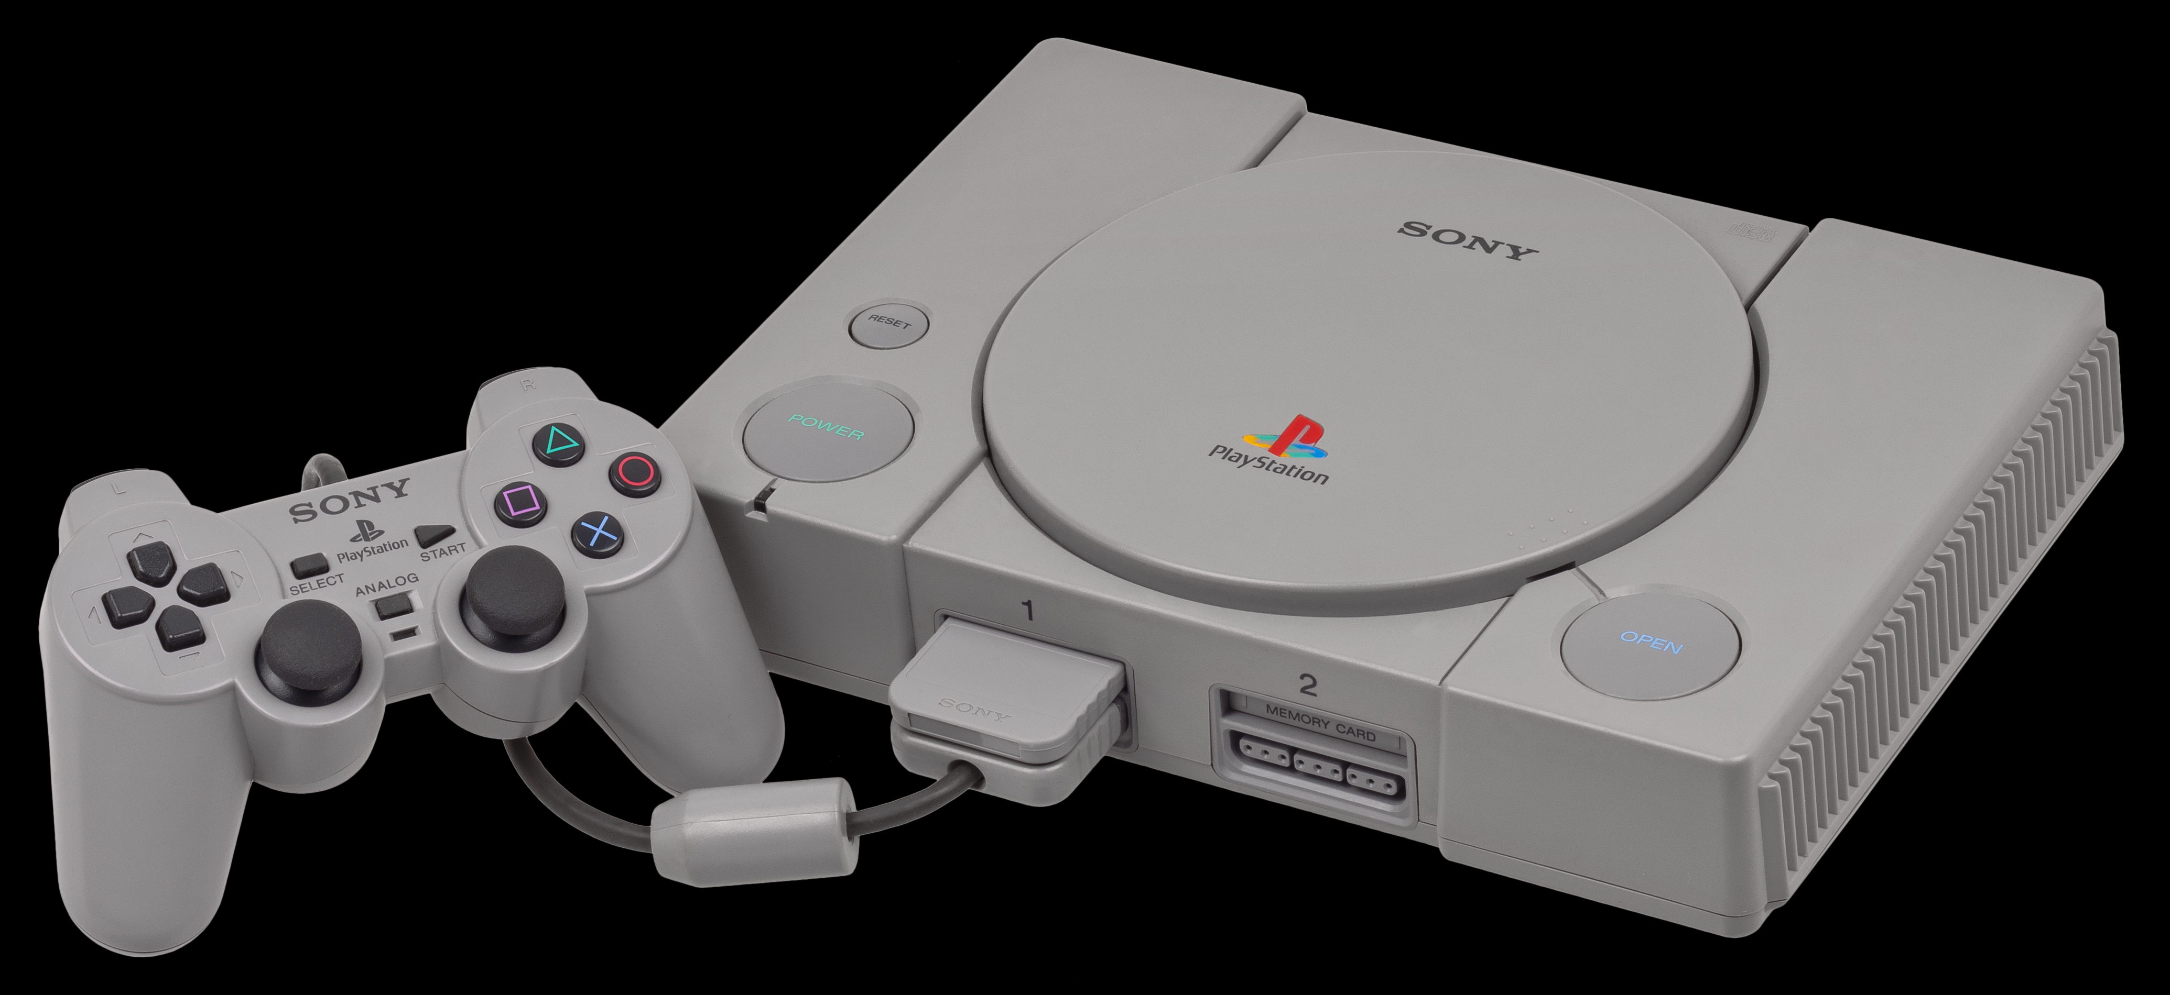
Compaq Deskpro 386
Apple PowerBook
Motorola 68000 de 16/32 Bits
SO System 7.0.1
Considerada como una de las computadoras más importantes de todos los tiempo
Procesador Intel 80386 de 32 Bits
BUS de datos de 16 Bits
SO Windows/386.
1986
1989
1991
1995
Procesador R3000A de 32 Bits
Creada en colaboración con Nintendo para desarrollar una versión de CD-ROM del Súper Nintendo
Procesador de 32 Bits
BUS de datos mejorado
Doblada el desempeño respecto a la 386
Intel 80486
Sony Playstation

Slide 19
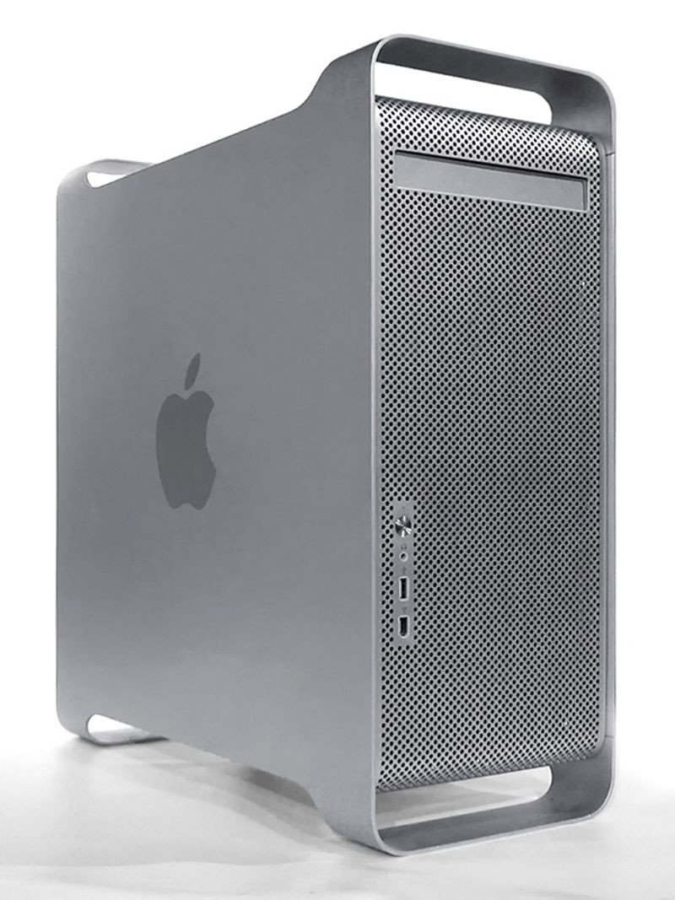
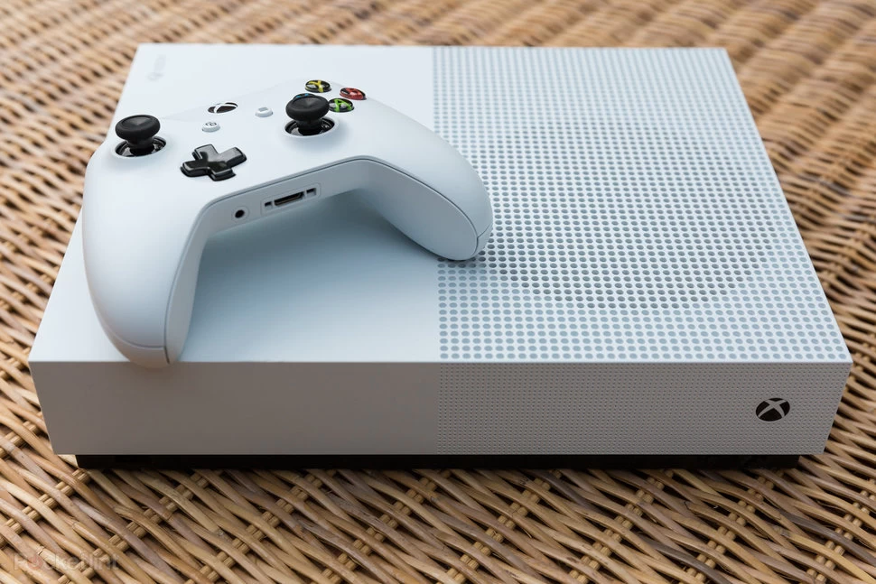
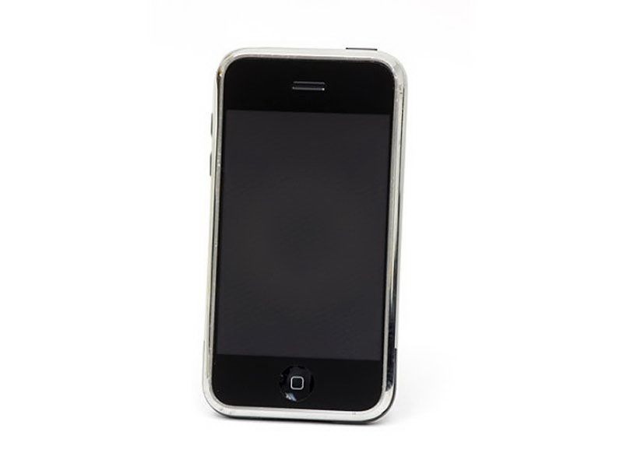
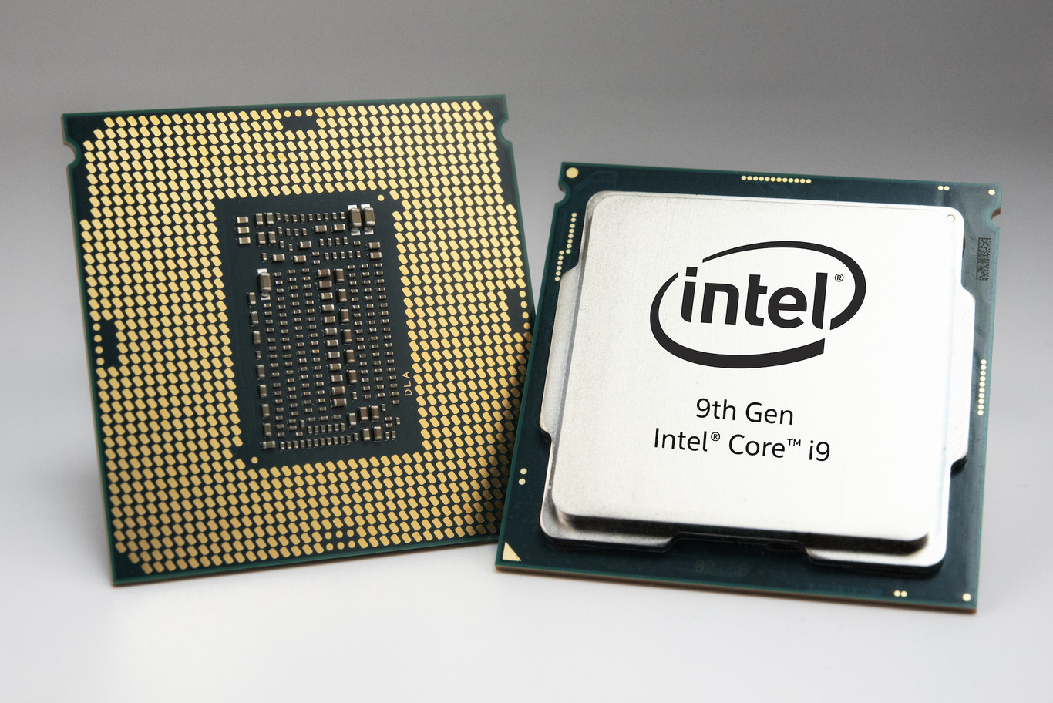
PowerMac G5
Microsoft Xbox One
AMD Jaguar CPU con dos módulos Quad-Core, sumando 8 núcleos de 64 bits
Soportaba 1080p y 720p
Procesador PowerPC 970 de 64 Bits
SO MacOS X.
Primera PC de 64 bits
2003
2007
2013
2018
Procesador de 10 núcleos de 64 Bits
Incorpora 7 mil millones de transistores en un volumen de 37.5 mm × 37.5 mm × 4.4 mm
Procesador de 32 Bits* (Samsung ARM11)
Combinaba web browsing, reproducción de música, y teléfono celular
Apple iPhone
Intel Core i9

Slide 20
Microchip fabrication process
TE2015 Microcontroladores

Slide 21
SEMICONDUCTORS FABRICATION PROCESS
Silicon (Si)
Transistors
Resistors
Diodes
Analog
Digital
Logic gates
Capacitors
Inductors
ALU
Memory
Control
Photolithography
Amplifiers, filters, etc.

Slide 22
SEMICONDUCTORS FABRICATION PROCESS
Photoresist coating
Mask aligment
UV exposure
Development
Processed wafer

Slide 23
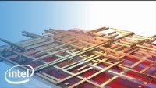

Slide 24
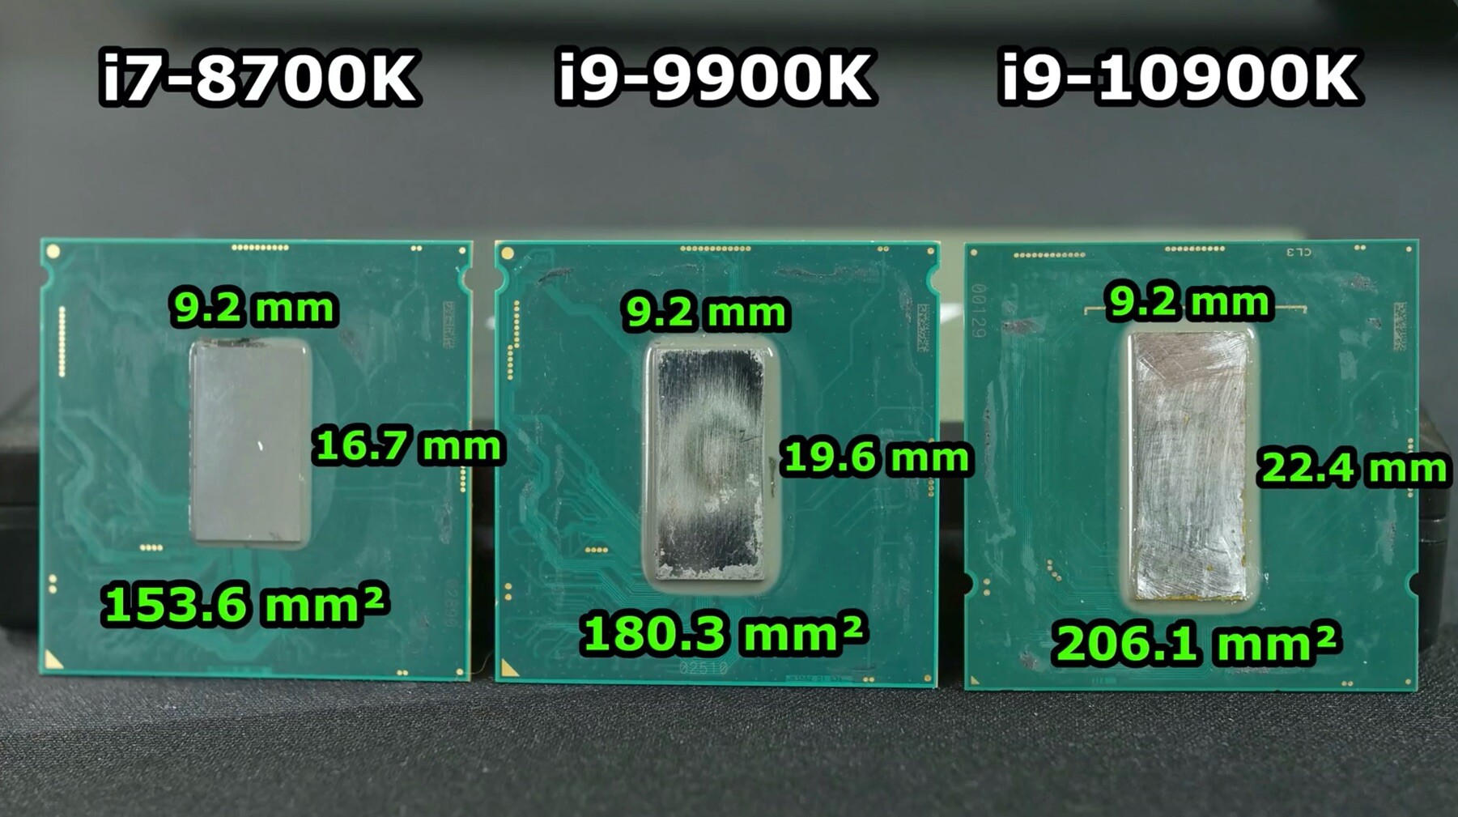
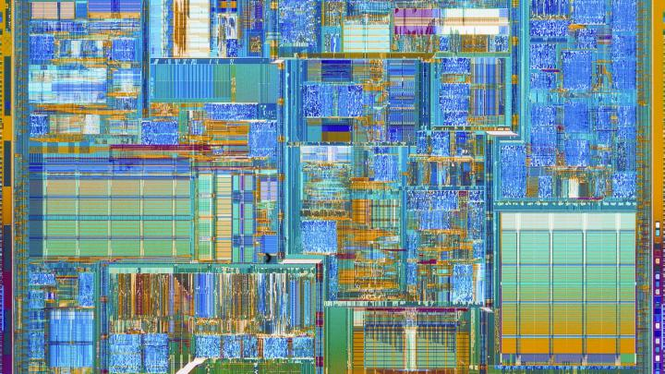
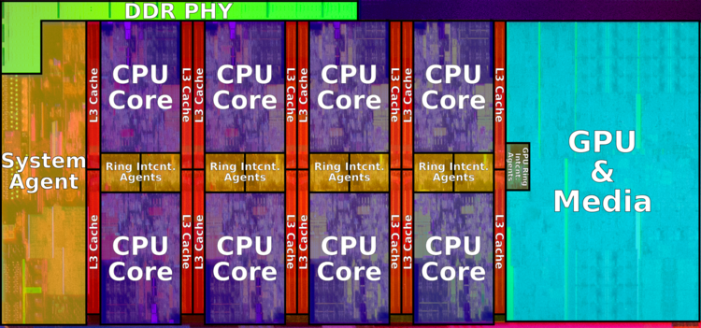
INTEL 4004 (1971)
INTEL CORE i9-9900K (2018)
2300 transistors in 4 mm x 3 mm
~7 billion transistors in 9.2 mm x 19.6 mm
192 transistors/mm²
39 million transistors/mm²

Slide 25
Von Neumann and Harvard Architectures
TE2015 Microcontroladores

Slide 26
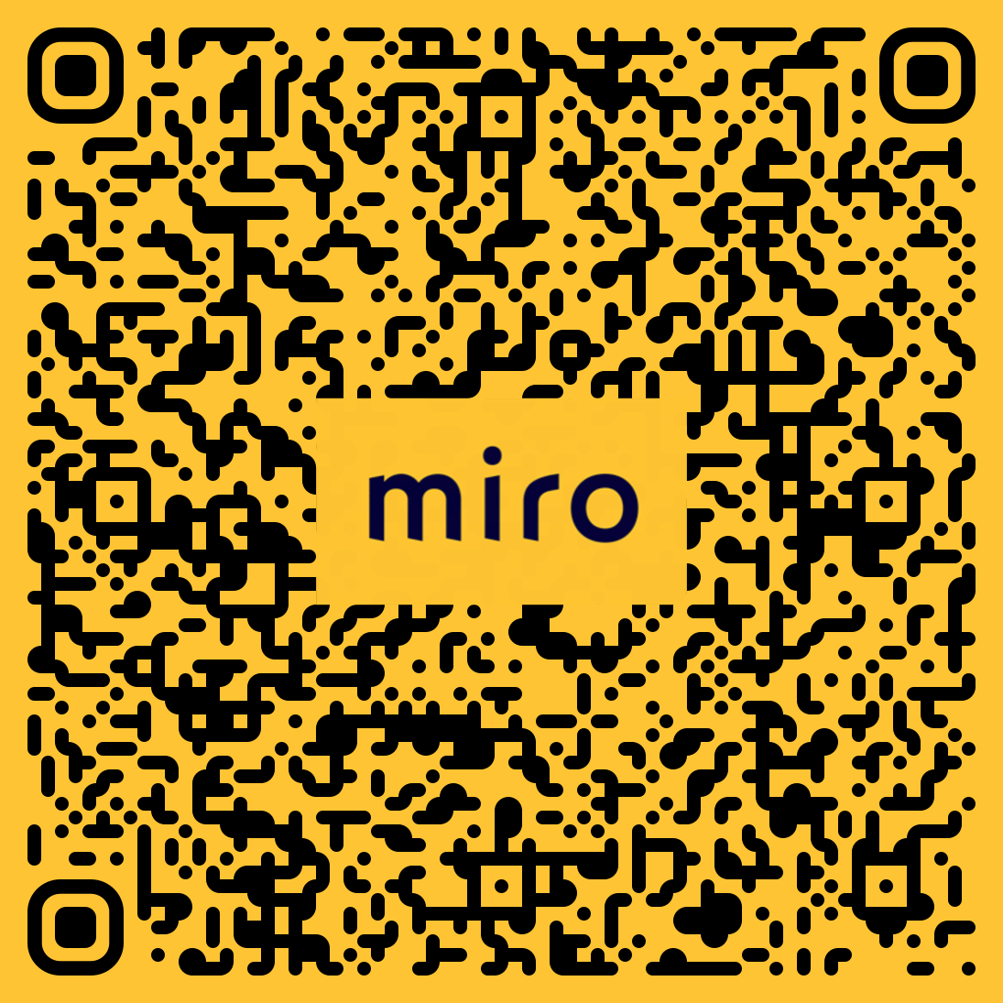
https://bit.ly/TE2015MIRO

Slide 27
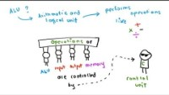
https://youtu.be/5BpgAHBZgec

Slide 28
VON NEUMANN ARCHITECTURE
The CPU includes the ALU and Control units, plus some Registers
Memory address bus is implicit in data bus between Control and Memory
Registers are small memories built into the CPU for fast access to data (low latency)
The main registers in this architecture are
Program counter (PC)
Accumulator (AC)
Memory address (MAR)
Memory data (MDR)
Instruction (IR)
Main memory holds instructions and data
The Input/Output unit is a signal conditioning stage for incoming/outcoming data
control
data
CENTRAL PROCESSING UNIT (CPU)
ALU
INPUT
OUTPUT
CONTROL
MEMORY

Slide 29
VON NEUMANN ARCHITECTURE
INSTRUCTION CYCLE
The Control unit fetches the next program instruction from main memory using the PC to determine where the instruction is located
The instruction is decoded so the ALU can understand it
Data operands required to execute the instruction are fetched from main memory and placed in registers in the CPU
The ALU executes the instruction and stores the result in registers or main memory
CPU
Registers
Program counter (PC)
Accumulator (AC)
Memory address (MAR)
Memory data (MDR)
Instruction (IR)
Others…
MEMORY
DATA
ALU
CONTROL
FETCH
DECODE
EXECUTE
PROGRAM
Input/Output

Slide 30
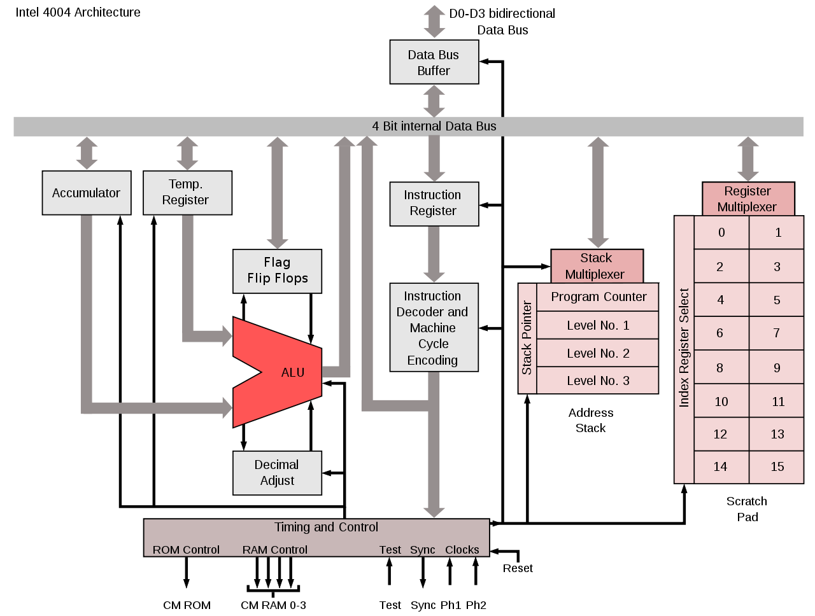
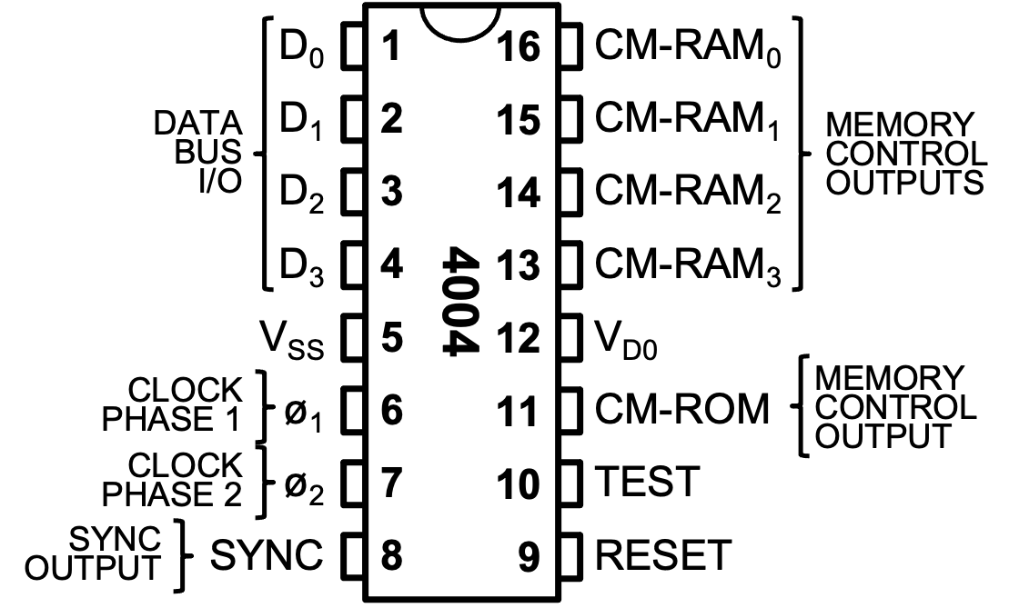
VON NEUMANN EXAMPLE: INTEL 4004
CPU
Registers
Program counter (PC)
Accumulator (AC)
Memory address (MAR)
Memory data (MDR)
Instruction (IR)
Others…
MEMORY
DATA
ALU
CONTROL
PROGRAM
MEMORY
Input/Output

Slide 31
VON NEUMANN VS HARVARD
CPU
address
Main Memory
DATA MEMORY
address
CPU
address
PROGRAM
MEMORY
DATA
data/instr.
data
instruction
PROGRAM
control
control
control
VON NEUMANN
Data and Program in the same physical memory
Single BUS that sequentially reads data and instructions
One instrution cycle to read an instruction
One instruction cycle to read data
Slower but simpler than Harvard
HARVARD
Data and program in separate physical memory
Fetch can be carried out while other instruction is in Execution
This is called Pipelining
Faster but more complex than Von Neumann

